Slide 1
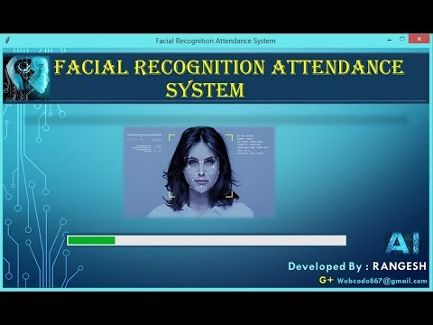
Face Recognition Based Attendance System software
SUBMITTED BY:
Rahul Rathore
Umang Saxena
Vibhor Kumar
Shubhrit Bhardwaj

Slide 2
What is FACE RECOGNITION ?
Introduction
A facial recognition system is a technology capable of identifying or verifying a person from a digital image or a video frame from a video source. There are multiple methods in which facial recognition systems work, but in general, they work by comparing selected facial features from given image with faces within a database.

Slide 3
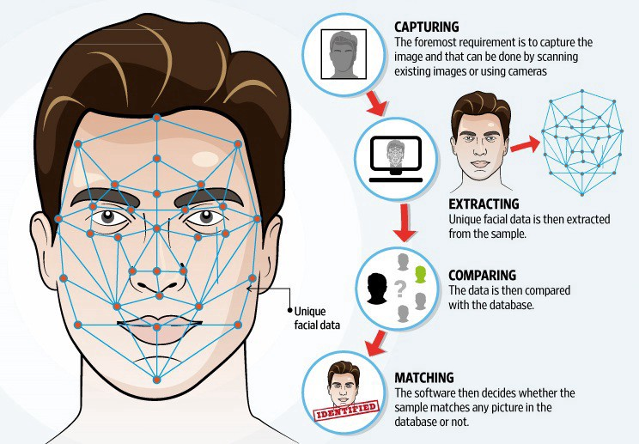
How Face Recognition works
How it works
The mathematical algorithms of biometric facial recognition follow several stages of image processing:
Capture The first step is for the system to collect physical or behavioral samples in predetermined conditions and during a stated period of time.
Extraction Then, all this gathered data should be extracted from the samples to create templates based on them.
Comparison After the extraction, collected data is compared with the existing templates.
Matching The final stage of face detection technology is to make a decision whether the face’s features of a new sample are matching with the one from a facial database or not. It usually takes just seconds

Slide 4
Implementation
The proposed model is based on face recognition mechanism. The basic methodology is presented in figure Whenever a student enters the class and comes across the camera module of the system his image is captured in the system and is recognized and validated if he is a student of the class. If recognized then his attendance is automatically marked via post processing of the system. The system architecture consists of various stages and steps ranging between creating dataset and updating of the database.

Slide 5
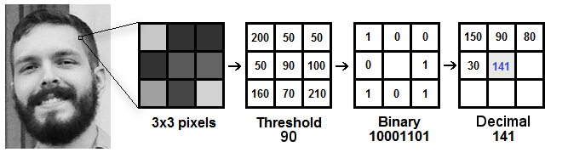
Face Detection and Recognition
Algorithm and comparing
· LBPH Face Recognizer Algorithm
Here, in LBPH algorithm the motive is to concentrate on local and small features of an image rather than looking at the whole. The algorithm compares the relative and local pixels of an image in order to generate the local set of the image structure.

Slide 6








Pros
We can overcome fake attendance
Save time & money
Energy savings
Efficiency
Pros
Better communication
Better Attendance
No paperwork is required
Business opportunities

Slide 7




Cons
Angle
Complexity
Image Quality
Storage

Slide 8
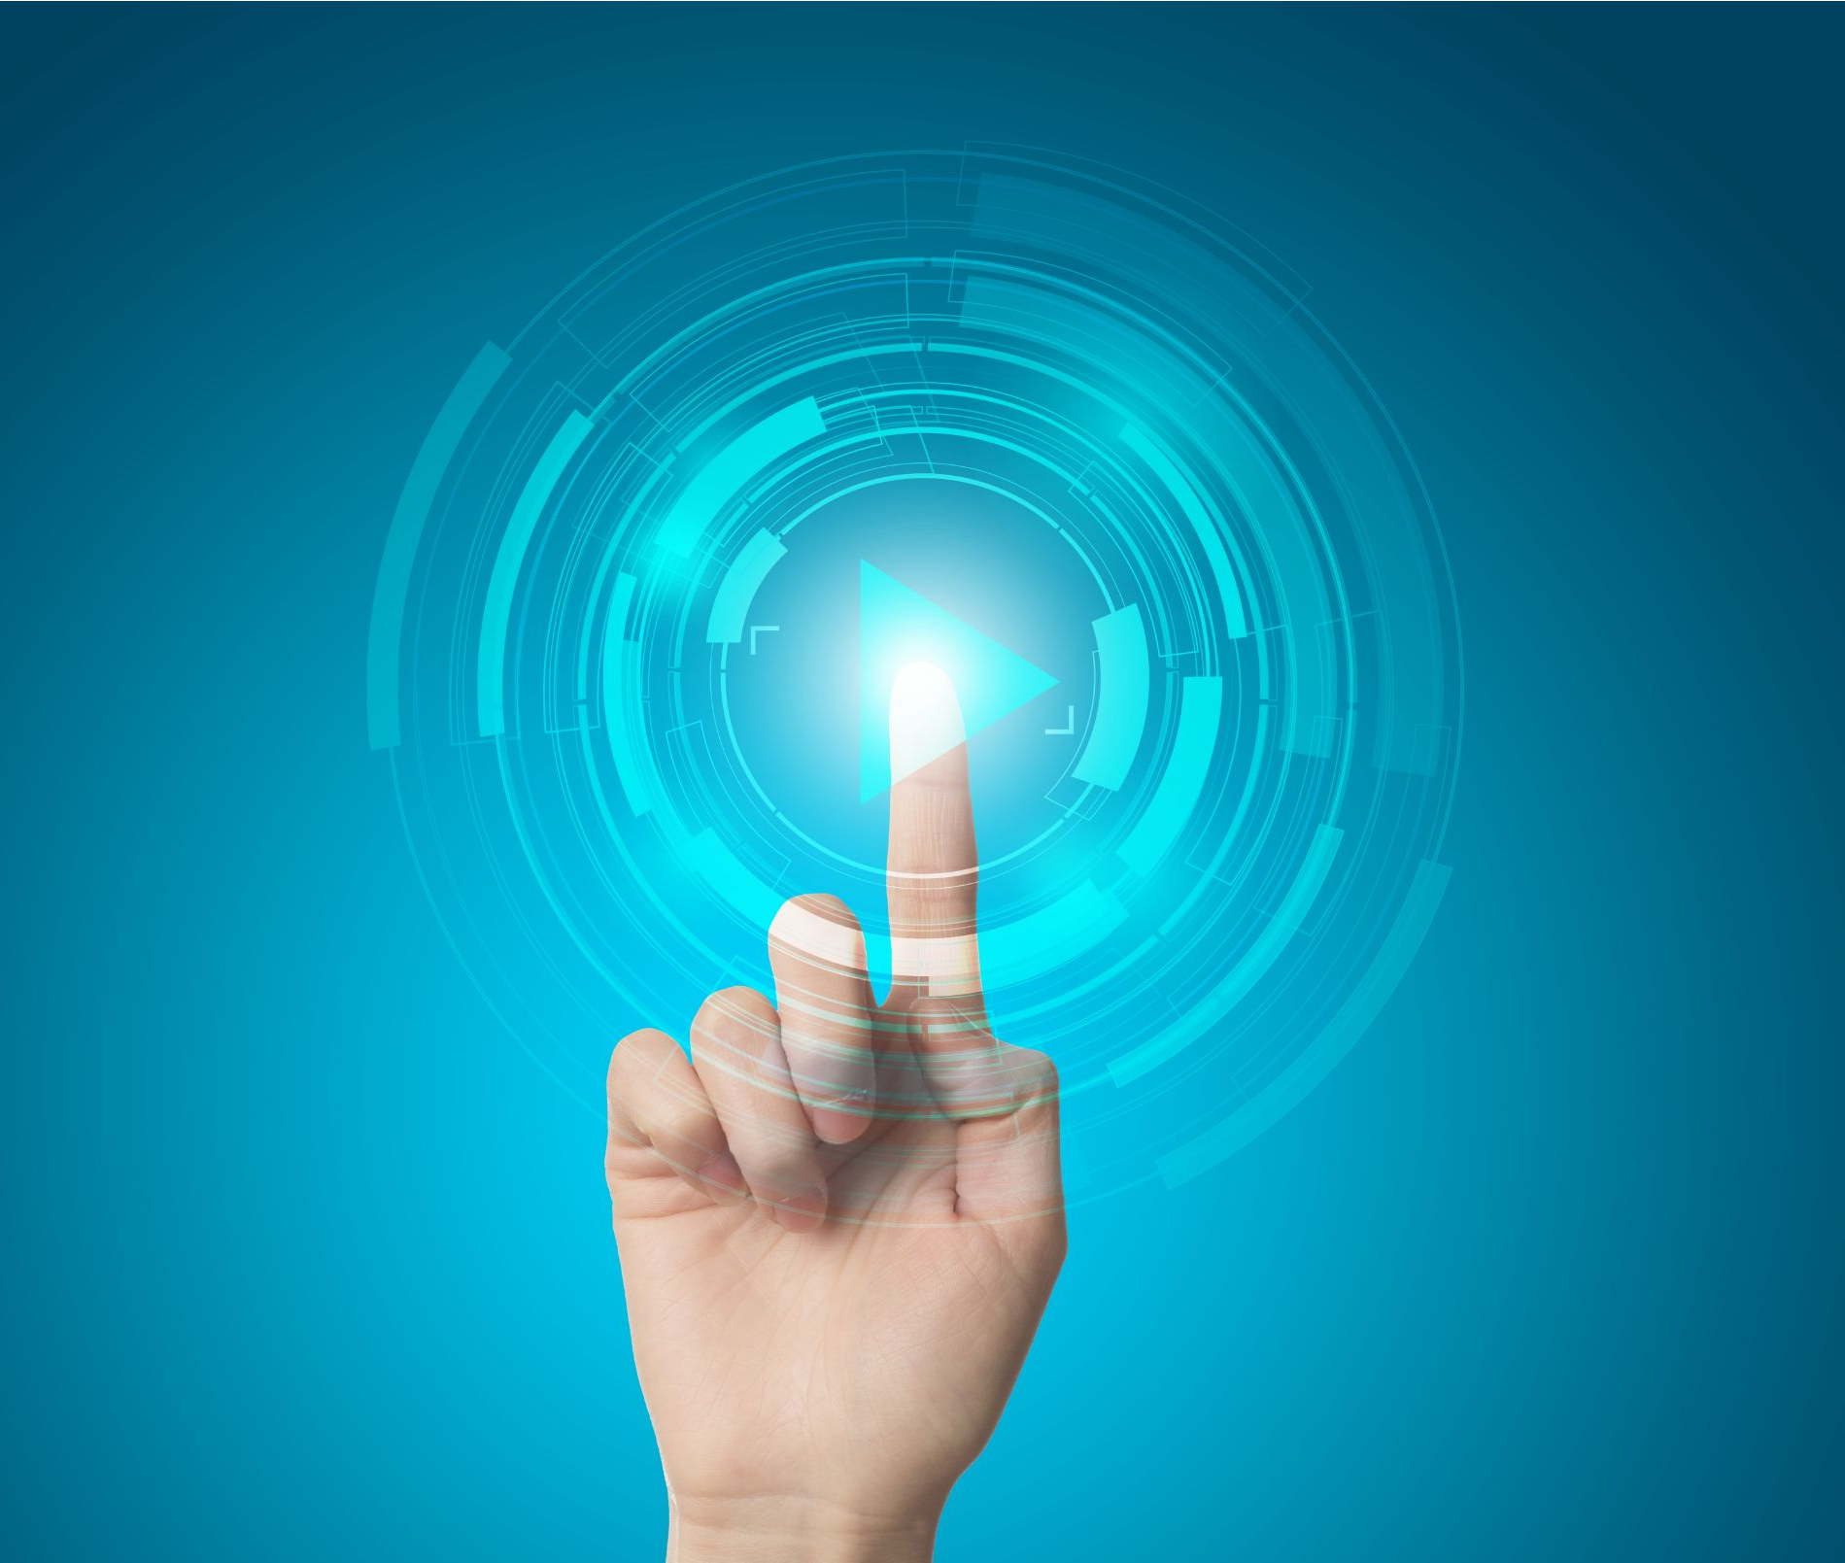
Conclusion
The purpose of reducing the errors that occur in the traditional attendance taking system has been achieved by implementing this automated attendance system. By using this technology we can overcome the problems of fake attendance .We can save time and efficiency is more. Summing it up, every new facial recognition technology represents huge perspectives and promises for the future evolution

